Slide 1

Tarjanee Sandeep Desai (QA Manager) Rahul Anand Nayenagali (QA Analyst) Harsh Moradiya (Business Analyst) Shloka Gupta (Business Analyst) Tanzil Bilal Mohammed (Software Tester)
Sakshi Singh (Software Tester) Kalpana Komateneni (Software Tester)
Sai Sandeep Mandava (Software Tester)
Madhu Kiran Thalluri (Software Tester)
Team 3

Slide 2
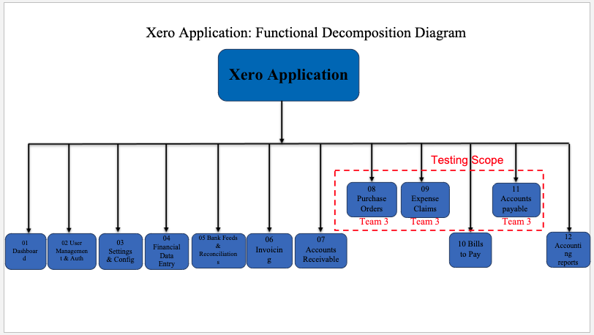
Functional Decomposition Diagram
(Madhu Kiran Thalluri)

Slide 3
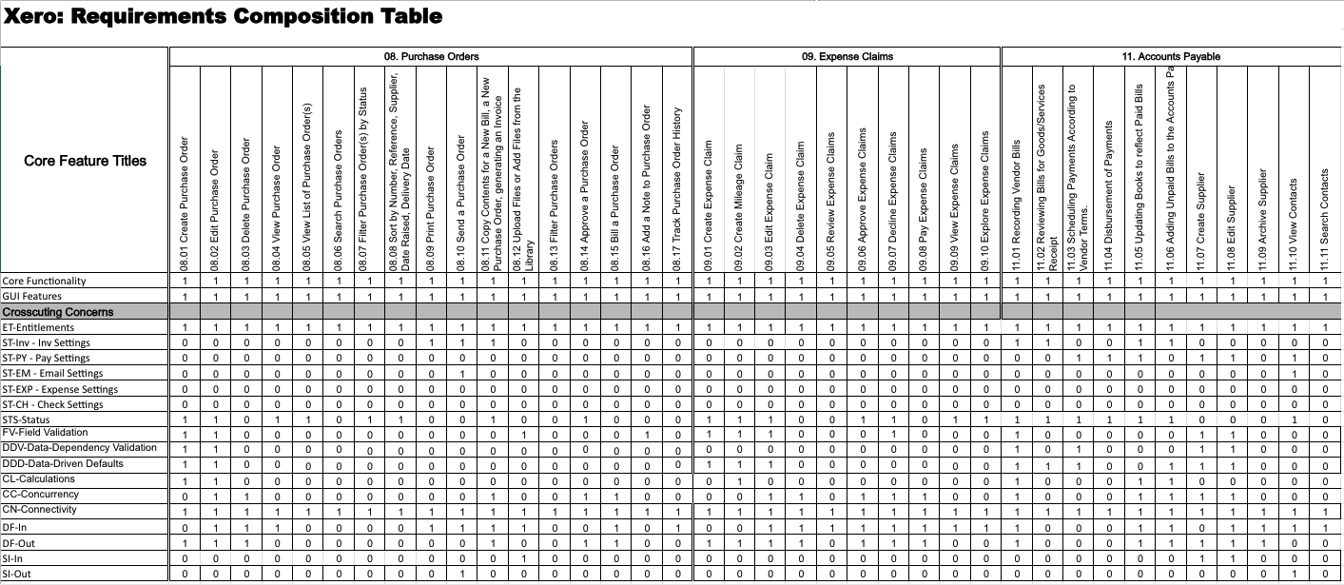
RCT (Tanzil Bilal Mohammed)

Slide 4
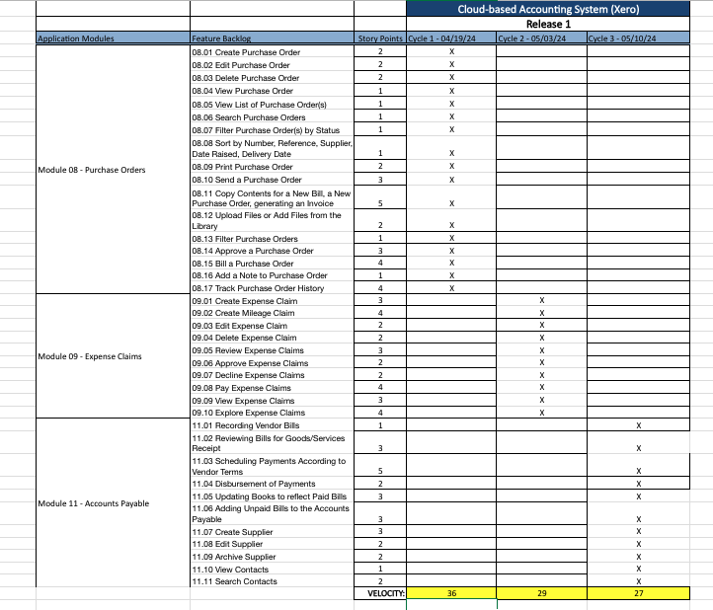
Testing RoadMap
(Sakshi Singh)

Slide 5
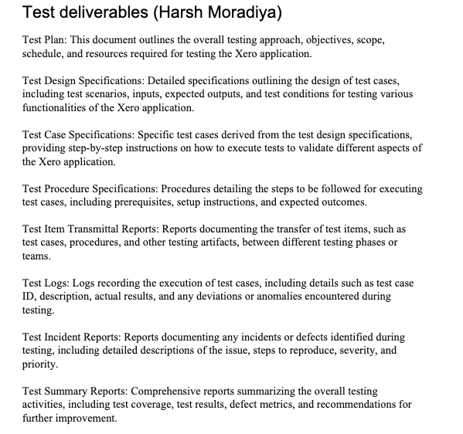
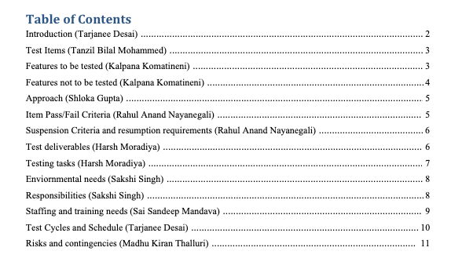
Test Plan
(Harsh Moradiya)

Slide 6
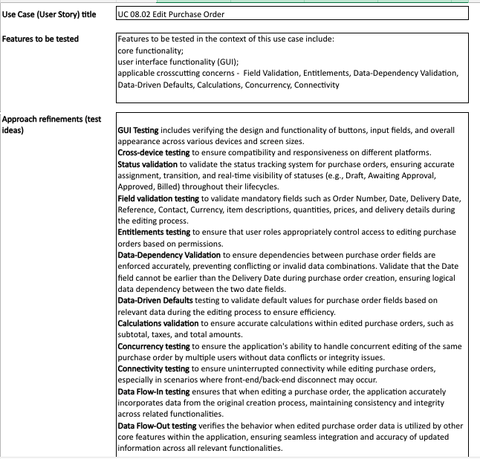
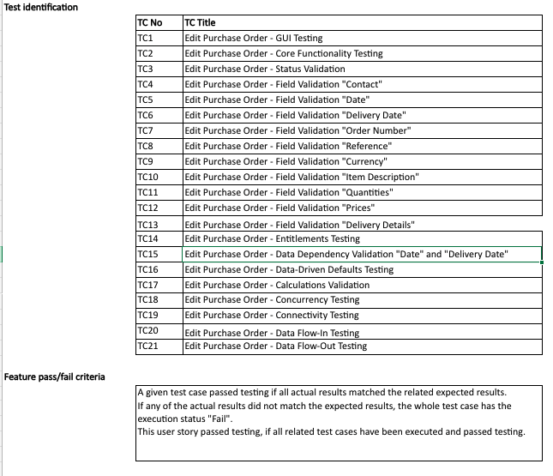
Test Design Specification
(Shloka Gupta)

Slide 7
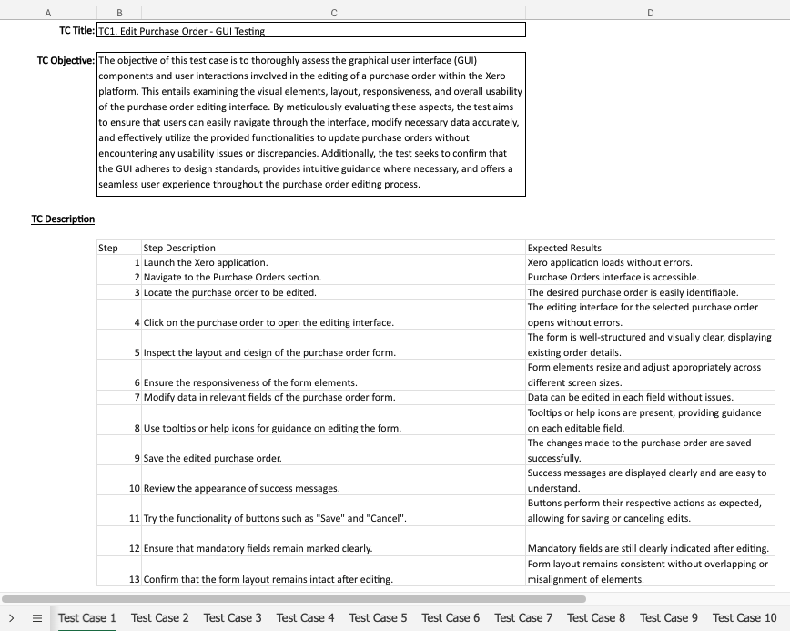
Test Case Specification
(Kalpana Komateneni & Sai Sandeep Manadava)

Slide 8
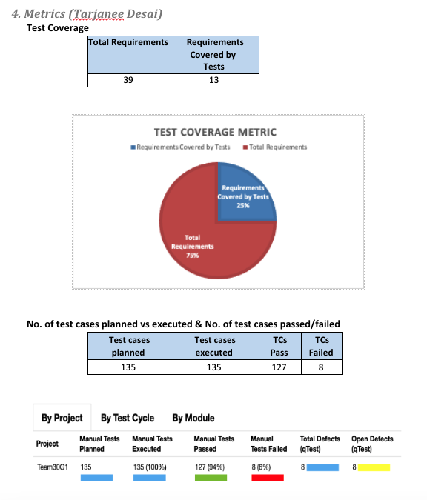
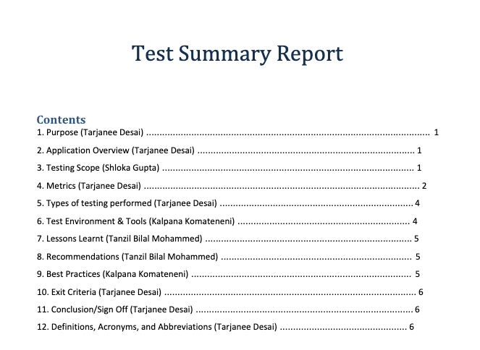
Test Summary Report
(Tarjanee Desai)

Slide 9
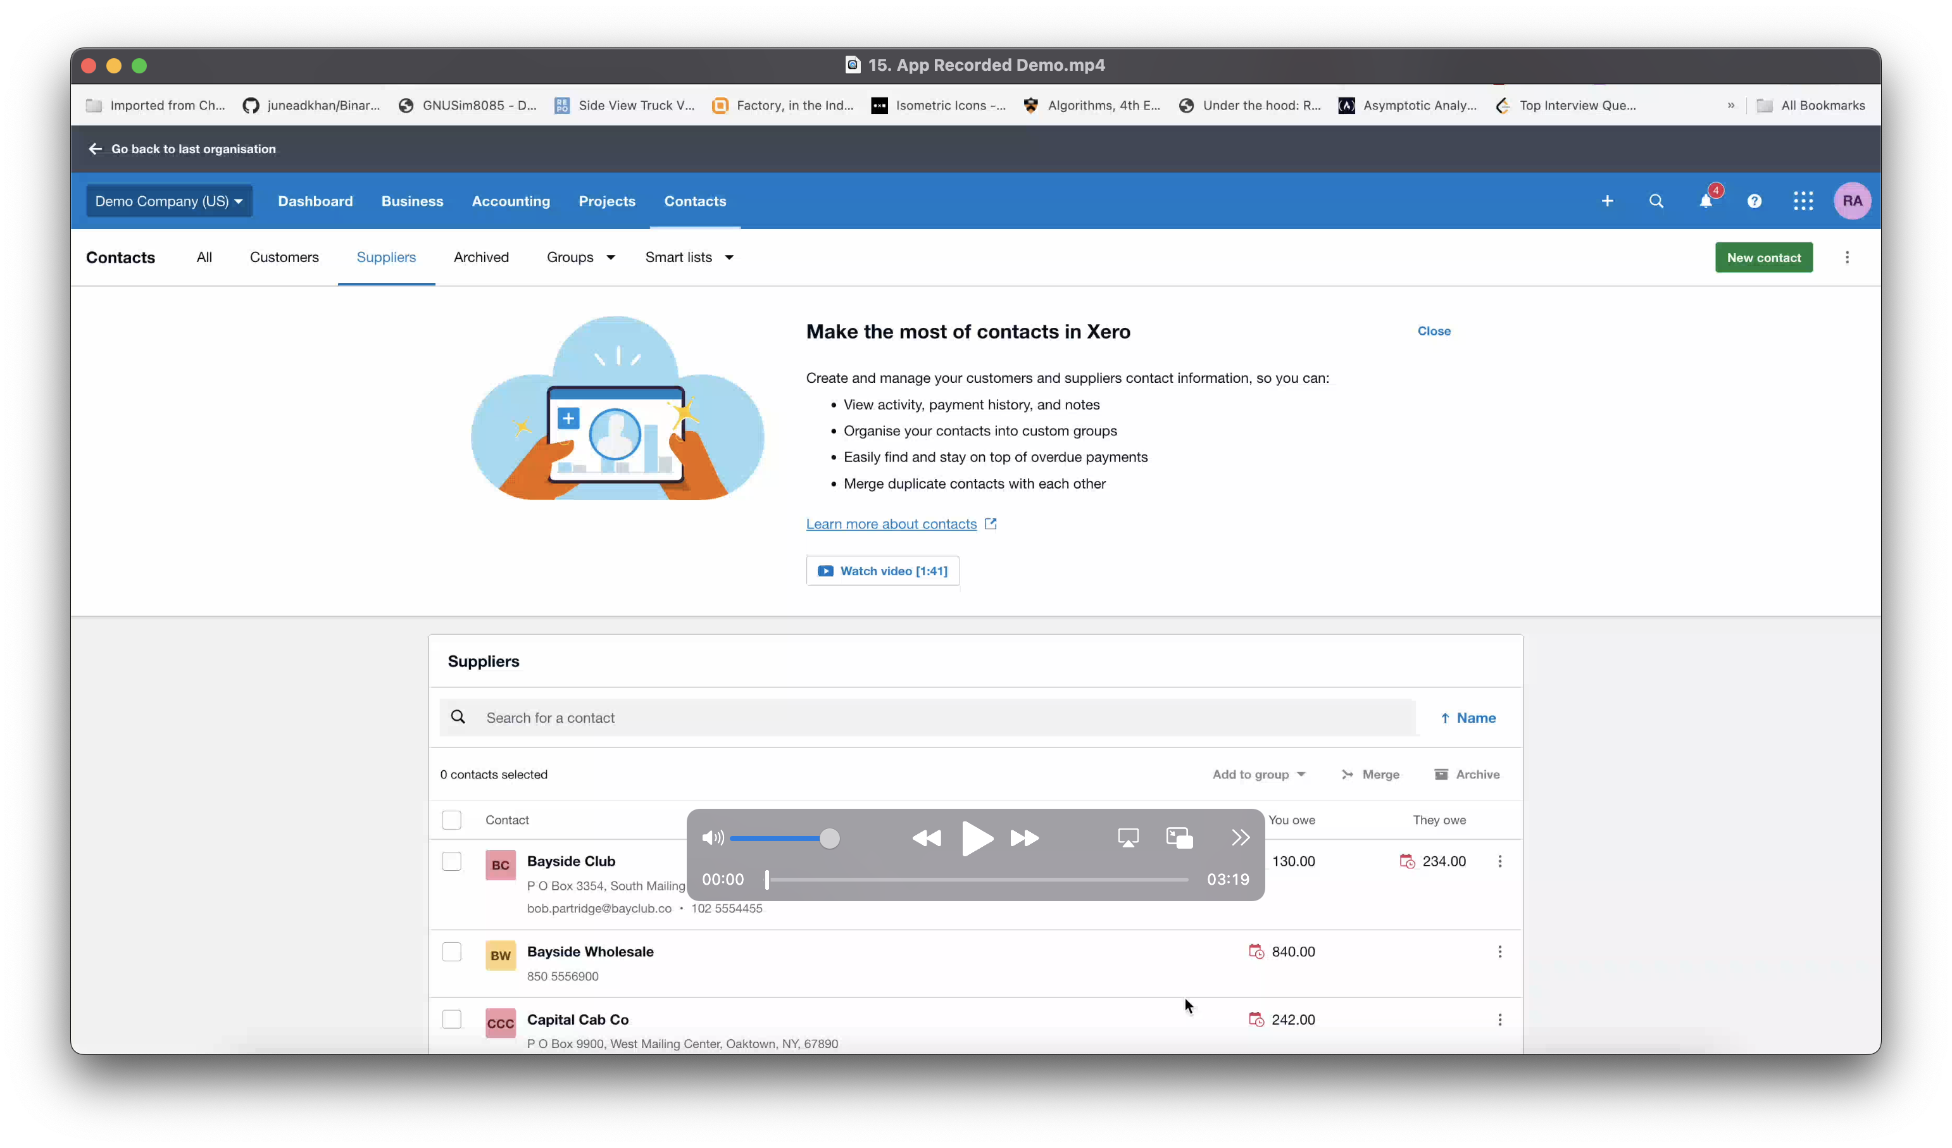
Application Recorded Demo
(Rahul Anand Nayanegali)

Slide 10
Appendix:
GitHub Repository

Slide 11

GitHub Repo Link
🔗 https://github.com/tarjaneed/CS631G-Software-Verification-Team-3

Slide 12


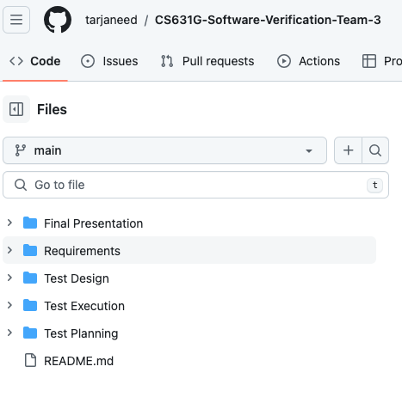

GitHub Repo Folder Structure
Requirements
Test Planning
Test Design
Test Execution
Final Presentation
README.md

Slide 13
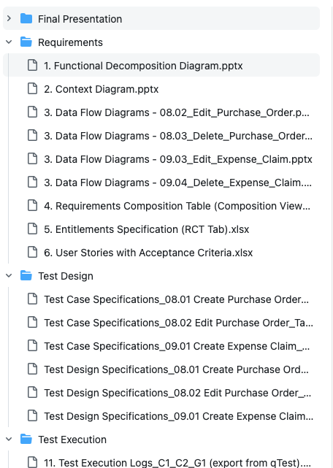
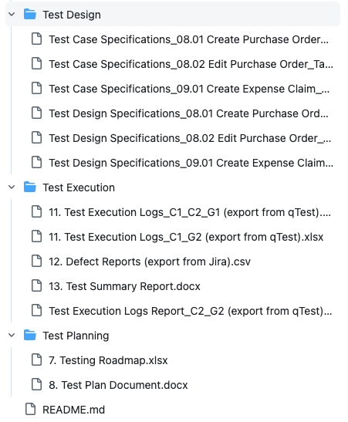
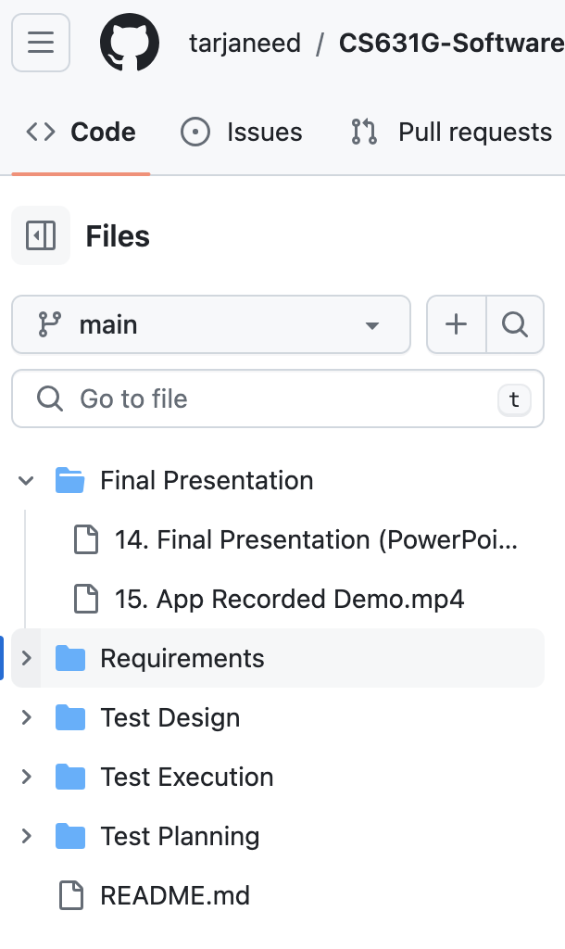
GitHub Repo Folder Structure

Slide 14
Thank You

